Slide 1
Lecture 3: Introduction to NumPy and Pandas

Slide 2
Python Libraries for Data Science
Popular Python toolboxes/libraries for data analytics
NumPy
SciPy (https://www.scipy-lectures.org/ )
Pandas
SciKit-Learn
Visualization libraries
Matplotlib, Pyplot
Seaborn https://seaborn.pydata.org/tutorial.html
and many more …
Anaconda contains all these libraries

Slide 3

Part I: Introduction to Numpy
Link: http://numpy.org

Slide 4

NumPy
Stands for Numerical Python
Introduces objects for multidimensional arrays and matrices, as well as functions that allow to easily perform advanced mathematical and statistical operations on those objects
Provides vectorization of mathematical operations on arrays and matrices which significantly improves the performance
Many other python libraries are built on NumPy

Slide 5
It provides
ndarray for creating multiple dimensional arrays
Standard math functions for fast operations on entire arrays of data without having to write loops
Internally stores data in a contiguous block of memory, independent of other built-in Python objects, use much less memory than built-in Python sequences.

Slide 6
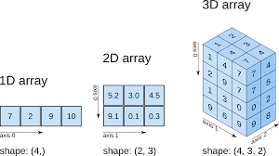
NumPy ndarray
We will focus on
Concept: ndarray vs list
Array creation
Array access and operations

Slide 7
ndarray (aka: numpy array, array) | Python lists
Storage of homogeneous data -- has a dtype (all all elements the same type) | Storage of heterogeneous data
Fixed size – need to define shape | Dynamic length
Memory allocation: contiguous, more compact | Not contiguous
Support convenient slicing, indexing | Also support
Support vectorized computation | Not support*
More efficient over large data | Flexible
*vectorize() defined in numpy; when a vectorized function applies to a normal list, the result automatically becomes an ndarray; see examples later.

Slide 8
Array: Contiguous storage
Reference: Understanding data types in Python
https://jakevdp.github.io/PythonDataScienceHandbook/02.01-understanding-data-types.html

Slide 9
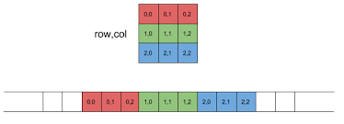
Storing 2-d arrays

Slide 10
ndarray Creation
data1 = [6, 7.5, 8, 0, 1]
arr1 = np.array(data1) #create 1-d array from a list
data2 = [[1, 2, 3, 4], [5, 6, 7, 8]] #list of lists
arr2 = np.array(data2) #2-d array
print(arr2.ndim) #2
Print(arr2.shape) # (2,4)

Slide 11
array = np.array([[0,1,2],[2,3,4]])
[[0 1 2]
[2 3 4]]
array = np.zeros((2,3))
[[0. 0. 0.]
[0. 0. 0.]]
array = np.ones((2,3))
[[1. 1. 1.]
[1. 1. 1.]]
array = np.eye(3)
[[1. 0. 0.]
[0. 1. 0.]
[0. 0. 1.]]
array = np.arange(0, 10, 2)
[0, 2, 4, 6, 8]
array = np.random.randint(0, 10, (3,3))
[[6 4 3]
[1 5 6]
[9 8 5]]
arange is an array-valued version of the built-in Python range function

Slide 12
Array Creation vs. List Creation
NumPy-based algorithms are generally 10 to 100 times faster (or more) than their pure Python counterparts and use significantly less memory.
import numpy as np
my_arr = np.arange(1000000)
my_list = list(range(1000000))
Note: For efficiency comparison, record the execution time of each of the above array creation actions – better use a loop to create 10 or more same size arrays/lists and then take average time.

Slide 13
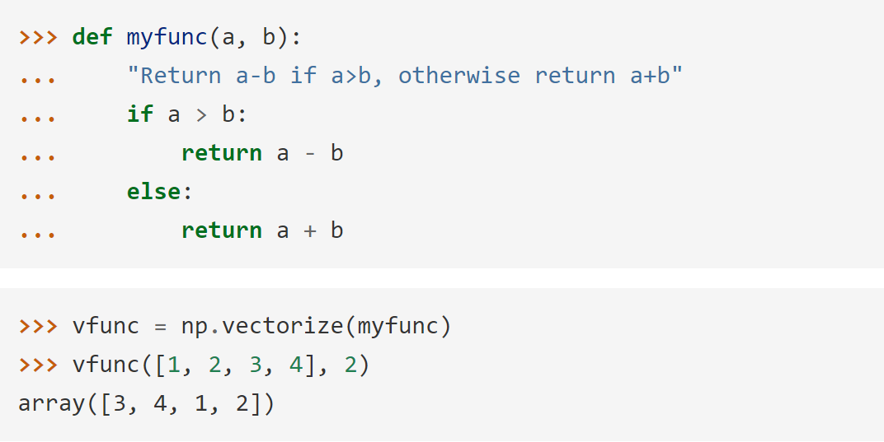
Vectorization
Vectorization: Express batch operations on data without using loops.

Slide 14
Arithmetic with NumPy Arrays
Any arithmetic operations between equal-size arrays applies the operation element-wise:
arr = np.array([[1., 2., 3.], [4., 5., 6.]])
print(arr)
[[1. 2. 3.]
[4. 5. 6.]]
print(arr * arr)
[[ 1. 4. 9.]
[16. 25. 36.]]
print(arr - arr)
[[0. 0. 0.]
[0. 0. 0.]]

Slide 15
Arithmetic operations with scalars propagate the scalar argument to each element in the array:
Comparisons between arrays of the same size yield a Boolean array:
arr = np.array([[1., 2., 3.], [4., 5., 6.]])
print(arr)
[[1. 2. 3.]
[4. 5. 6.]]
print(arr **2)
[[ 1. 4. 9.]
[16. 25. 36.]]
arr2 = np.array([[0., 4., 1.], [7., 2., 12.]])
print(arr2)
[[ 0. 4. 1.]
[ 7. 2. 12.]]
print(arr2 > arr)
[[False True False]
[ True False True]]

Slide 16
Slicing
One-dimensional arrays are simple; on the surface they act similarly to Python lists:
arr = np.arange(10)
print(arr) # [0 1 2 3 4 5 6 7 8 9]
print(arr[5]) #5
print(arr[5:8]) #[5 6 7]
arr[5:8] = 12 #assignment
print(arr) #[ 0 1 2 3 4 12 12 12 8 9]

Slide 17
As you can see, if you assign a scalar value to a slice, as in arr[5:8] = 12, the value is propagated (or broadcasted) to the entire selection.
An important first distinction from Python’s built-in lists is that array slices are views on the original array.
This means that the data is not copied, and any modifications to the view will be reflected in the source array.
arr = np.arange(10)
print(arr) # [0 1 2 3 4 5 6 7 8 9]
arr_slice = arr[5:8]
print(arr_slice) # [5 6 7]
arr_slice[1] = 12345
print(arr) # [0 1 2 3 4 5 12345 7 8 9]
arr_slice[:] = 64
print(arr) # [ 0 1 2 3 4 64 64 64 8 9]
#Now check the result of this code
lst = list(range(10))
lst_slice = lst[5:8]
print(lst_slice)
lst_slice[1] = 12345
print(lst)
Notes:
As NumPy has been designed to be able to work with very large arrays, you could imagine performance
and memory problems if NumPy insisted on always copying data.
If you want a copy of a slice of an ndarray instead of a view, you
will need to explicitly copy the array—for example,
arr[5:8].copy().

Slide 18
Indexing
In a two-dimensional array, the elements at each index are no longer scalars but rather one-dimensional arrays:
Thus, individual elements can be accessed recursively. But that is a bit too much work, so you can pass a comma-separated list of indices to select individual elements.
These are equivalent:
arr2d = np.array([[1, 2, 3], [4, 5, 6], [7, 8, 9]])
print(arr2d[2]) # [7 8 9]
print(arr2d[0][2]) #3
print(arr2d[0, 2]) #3

Slide 19
Activity #1: Show the output
Create a one-dimensional array arr1d of 12 elements using arange, a two-dimensional array arr2d of from the list [[1,2,3],[6,5,4]], print out these two arrays.
Create a slice s of [4,5,6] from arr1d, set s[1] = 0, print out s as well as arr1d.
Apply vectorized computation of factorial to each element of arr2d.

Slide 20
Part II: Introduction to Panda
Link: http://pandas.pydata.org/

Slide 21
Pandas: Python Data Analysis Library
adds data structures and tools designed to work with table-like data
provides tools for data manipulation: reshaping, merging, sorting, slicing, aggregation etc.
allows handling missing data

Slide 22
Overview
Created by Wes McKinney in 2008, now maintained by many others.
Author of one of the textbooks: Python for Data Analysis
Powerful and productive Python data analysis and Management Library
Panel Data System
The name is derived from the term "panel data", an econometrics term for data sets that include both time-series and cross-sectional data
Its an open source product.

Slide 23
What we use Pandas for?
Data Preparation
Reading Data
Selecting and Filtering the Data
Data manipulation: e.g. sorting, grouping, rearranging
Data analysis
Descriptive statistics
Inferential statistics
Data Visualization
Plotting the data

Slide 24
Pandas: key components
Note: Due to constant change of software versions some codes used here may be outdated. Students are encouraged to make adjustments.
It is built on top of NumPy
Key components provided by Pandas:
Series
DataFrame
From now on: (always put on top of your code)
from pandas import Series, DataFrame
import pandas as pd

Slide 25
Series vs. DataFrame
Series
one-dimensional labeled array capable of holding data of any type. The axis labels are collectively called index.
DataFrame
Two-dimensional size-mutable, potentially heterogeneous tabular data structure with labeled axes (rows and columns). Can be thought of as a dict-like container for Series objects.
https://www.geeksforgeeks.org/

Slide 26
Reading data using pandas
#Read csv file
df = pd.read_csv("Salaries.csv")
There is a number of pandas commands to read other data formats:
pd.read_excel('myfile.xlsx',sheet_name='Sheet1', index_col=None, na_values=['NA'])
pd.read_stata('myfile.dta')
pd.read_sas('myfile.sas7bdat')
pd.read_hdf('myfile.h5','df’)
Note: Salaries.csv available to download from Reference 1 Github link.

Slide 27
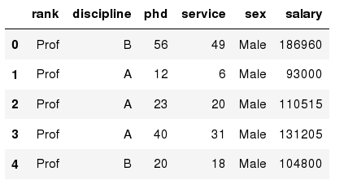
Exploring data frames
#List first 5 records
df.head()

Slide 28
Activity #2
Try to read the first 10, 20, 50 records;
Discussion: How to view the last few records?

Slide 29
Data Frame data types
Pandas Type | Native Python Type | Description
object | string | The most general dtype. Will be assigned to your column if column has mixed types (numbers and strings).
int64 | int | Numeric characters. 64 refers to the memory allocated to hold this character.
float64 | float | Numeric characters with decimals. If a column contains numbers and NaNs(see below), pandas will default to float64, in case your missing value has a decimal.
datetime64, timedelta[ns] | N/A (but see the datetime module in Python’s standard library) | Values meant to hold time data. Look into these for time series experiments.

Slide 30
Data Frame data types: Examples
#Check a particular column type
df['salary'].dtype
Output: dtype('int64')
#Check types for all the columns
df.dtypes
Output:
rank
discipline
phd
service
sex
salary
dtype: object
object
object
int64
int64
object
int64

Slide 31
Data Frames attributes
Python objects have attributes and methods.
df.attribute | description
dtypes | list the types of the columns
columns | list the column names
axes | list the row labels and column names
ndim | number of dimensions
size | number of elements
shape | return a tuple representing the dimensionality
values | numpy representation of the data

Slide 32
Activity #3
Write Pandas code to
Find how many records this data frame has;
How many elements are there?
What are the column names?
What types of columns we have in this data frame?

Slide 33
Data Frames methods
Unlike attributes, python methods have parenthesis.
All attributes and methods can be listed with a dir() function: dir(df)
df.method() | description
head( [n] ), tail( [n] ) | first/last n rows
describe() | generate descriptive statistics (for numeric columns only)
max(), min() | return max/min values for all numeric columns
mean(), median() | return mean/median values for all numeric columns
std() | standard deviation
sample([n]) | returns a random sample of the data frame
dropna() | drop all the records with missing values

Slide 34
Activity #4
Assume we have read in a CSV score file, say scores.csv.
Give the summary for the numeric columns in the dataset
Calculate standard deviation for all numeric columns;
What are the mean values of the first 50 records in the dataset?
Hint: use head() method to subset the first 50 records and then calculate the mean

Slide 35
Selecting a column in a Data Frame
Method 1: Subset the data frame using column name:
df['sex']
Method 2: Use the column name as an attribute:
df.sex
Note: there is an attribute rank for pandas data frames, so to select a column with a name "rank" we should use method 1.

Slide 36
Activity #5
#Salaries.csv
Calculate the basic statistics for the salary column;
Find how many values in the salary column
use count method
Calculate the average salary

Slide 37
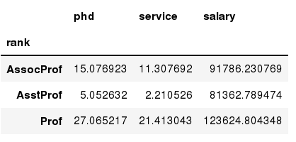
Data Frames groupby method
Using "group by" method we can:
Split the data into groups based on some criteria
Calculate statistics (or apply a function) to each group
#Group data using rank
df_rank = df.groupby(['rank'])
#Calculate mean value for each numeric column per each group
df_rank.mean()

Slide 38
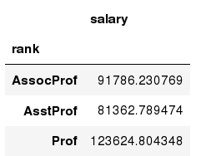
Data Frames groupby method
Once groupby object is create we can calculate various statistics for each group:
#Calculate mean salary for each professor rank:
df.groupby('rank')[['salary']].mean()
Note: If single brackets are used to specify the column (e.g. salary), then the output is Pandas Series object. When double brackets are used the output is a Data Frame

Slide 39
Data Frames groupby method
groupby performance notes:
no grouping/splitting occurs until it's needed.
Creating the groupby object only verifies that you have passed a valid mapping
by default the group keys are sorted during the groupby operation.
You may want to pass sort=False for potential speedup:
#Calculate mean salary for each professor rank:
df.groupby(['rank'], sort=False)[['salary']].mean()

Slide 40
Data Frame: filtering
To subset the data we can apply Boolean indexing. This indexing is commonly known as a filter. For example if we want to subset the rows in which the salary value is greater than $120K:
#Calculate mean salary for each professor rank:
df_sub = df[ df['salary'] > 120000 ]
Any Boolean operator can be used to subset the data:
> greater; >= greater or equal;
< less; <= less or equal;
== equal; != not equal;
#Select only those rows that contain female professors:
df_f = df[ df['sex'] == 'Female' ]

Slide 41
Data Frames: Slicing
There are a number of ways to subset the Data Frame:
one or more columns
one or more rows
a subset of rows and columns
Rows and columns can be selected by their position or label

Slide 42
Data Frames: Slicing
When selecting one column, it is possible to use single set of brackets, but the resulting object will be a Series (not a DataFrame):
#Select column salary:
df['salary']
When we need to select more than one column and/or make the output to be a DataFrame, we should use double brackets:
#Select column salary:
df[['rank','salary']]

Slide 43
Data Frames: Selecting rows
If we need to select a range of rows, we can specify the range using ":"
#Select rows by their position:
df[10:20]
Note: the first row has a position 0, and the last value in the range is omitted. For example, 0:10 range the first 10 rows are returned with the positions starting with 0 and ending with 9

Slide 44
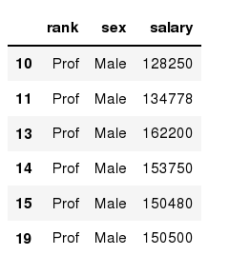
Data Frames: method loc
If we need to select a range of rows, using their labels we can use method loc:
#Select rows by their labels:
df_sub.loc[10:20,['rank','sex','salary']]

Slide 45
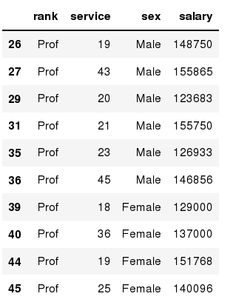
Data Frames: method iloc
If we need to select a range of rows and/or columns, using their positions we can use method iloc:
#Select rows by their labels:
df_sub.iloc[20:50,[0, 3, 4, 5]]

Slide 46
Data Frames: method iloc (summary)
df.iloc[0] # First row of a data frame
df.iloc[i] #(i+1)th row
df.iloc[-1] # Last row
df.iloc[:, 0] # First column
df.iloc[:, -1] # Last column
df.iloc[0:7] #First 7 rows
df.iloc[:, 0:2] #First 2 columns
df.iloc[1:3, 0:2] #2nd through 3rd rows and first 2 columns
df.iloc[[0,5], [1,3]] #1st & 6th rows and 2nd & 4th columns

Slide 47
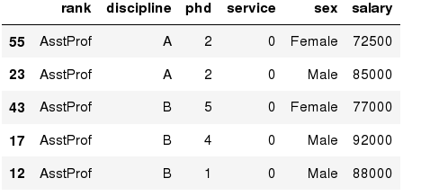
Data Frames: Sorting
We can sort the data by a value in the column. By default the sorting will occur in ascending order and a new data frame is return.
# Create a new data frame from the original sorted by the column Service
df_sorted = df.sort_values( by ='service')
df_sorted.head()

Slide 48
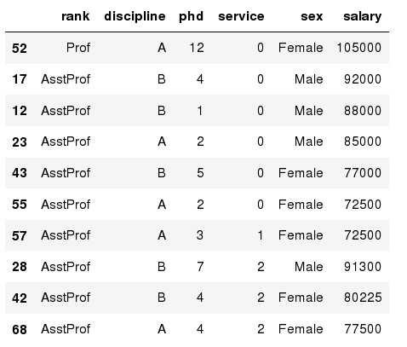
Data Frames: Sorting
We can sort the data using 2 or more columns:
df_sorted = df.sort_values( by =['service', 'salary'], ascending = [True, False])
df_sorted.head(10)

Slide 49
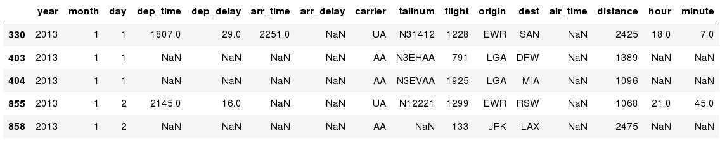
Missing Values
Missing values are marked as NaN
# Read a dataset with missing values
flights = pd.read_csv("flights.csv“)
# Select the rows that have at least one missing value
flights[flights.isnull().any(axis=1)].head()

Slide 50
Missing Values
There are a number of methods to deal with missing values in the data frame:
df.method() | description
dropna() | Drop missing observations
dropna(how='all') | Drop observations where all cells is NA
dropna(axis=1, how='all') | Drop column if all the values are missing
dropna(thresh = 5) | Drop rows that contain less than 5 non-missing values
fillna(0) | Replace missing values with zeros
isnull() | returns True if the value is missing
notnull() | Returns True for non-missing values

Slide 51
Missing Values
When summing the data, missing values will be treated as zero
If all values are missing, the sum will be equal to NaN
cumsum() and cumprod() methods ignore missing values but preserve them in the resulting arrays
Missing values in GroupBy method are excluded
Many descriptive statistics methods have skipna option to control if missing data should be excluded . This value is set to True by default

Slide 52
Aggregation Functions in Pandas
Aggregation - computing a summary statistic about each group, i.e.
compute group sums or means
compute group sizes/counts
Common aggregation functions:
min, max
count, sum, prod
mean, median, mode, mad #mad: Mean Absolute Deviation
std, var

Slide 53
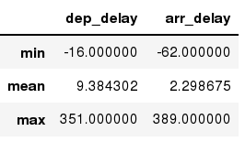
Aggregation Functions in Pandas
agg() method are useful when multiple statistics are computed per column:
flights[['dep_delay','arr_delay']].agg(['min','mean','max'])

Slide 54
Basic Descriptive Statistics
df.method() | description
describe | Basic statistics (count, mean, std, min, quantiles, max)
min, max | Minimum and maximum values
mean, median, mode | Arithmetic average, median and mode
var, std | Variance and standard deviation
sem | Standard error of mean
skew | Sample skewness
kurt | kurtosis

Slide 55
Summary
NumPy and Pandas are two important Python libraries and fundamental data structures for data analysis
We’ve discussed basic functions in these two libraries
More to cover and/or self-study
Next Lecture: Big Data Analysis: building practical applications
Assignment:
Pandas practice
Assignment #2

